Slide 1
ME 366: HEAT TRANSFER
COURSE INTRODUCTION
ME 366: HEAT TRANSFER is a dynamic thermo-science course in the BSc. Mechanical Engineering Year 3 programme taken in the second semester. It is a theory course and carries 3 credits.
COURSE OVERVIEW
This six-unit course module, with 34 worked-examples, 26 Self-Assessment questions and 48 Tutorial-problems, is a one-semester course in heat transfer designed for undergraduate engineering students. The text covers the basic principles of heat transfer with a broad range of engineering applications. The course module is used to extend thermodynamic analysis through the study of the modes of heat transfer and through the development of relations to calculate heat transfer rates.
Notes:
ME 366 LECTURE #1 INTRODUCTION AND UNIT 1 1

Slide 2
FUNDAMENTAL LAWS AND CONCEPTS
As shown in Figure 1, we refer to different types of heat transfer processes as modes. Traditionally, three modes of heat transfer are recognised, namely: conduction, convection, and radiation. It is certainly a rare instance when one encounters a problem of practical interest, which does not involve at least two, and sometimes all three, of these modes occurring simultaneously.
Notes:
ME 366 LECTURE #1 INTRODUCTION AND UNIT 1 2

Slide 3
MODES OF HEAT TRANSFER
The three modes of heat transfer illustrated schematically
Notes:
ME 366 LECTURE #1 INTRODUCTION AND UNIT 1 3

Slide 4
CONDUCTION HEAT TRANSFER
Heat conduction is that mode of energy transfer between solids brought into direct contact having different temperatures or within solids as a result of temperature difference or with liquids or gases as a result of temperature difference without an appreciable movement of matter.
This takes places as a result of kinetic motion or direct impact of molecules, as in the case of fluid at rest, and by the drift of electrons as in the case of metals. In a solid, which is a good electric conductor a large number of free electrons move about in the lattice; hence materials that are good electric conductors are generally good heat conductors (e.g. copper, silver etc)
Notes:
ME 366 LECTURE #1 INTRODUCTION AND UNIT 1 4

Slide 5
FOURIER’S LAW OF HEAT CONDUCTION
The basic law of heat conduction is the Fourier’s law.
It states that the rate of flow of heat through a single homogenous solid is directly proportional to the area A of the section at right angles to the direction of heat flow, and to the change of temperature with respect to the length of the path of heat flow, dT/dx.
This is an empirical law based on observation (i.e. based on experimentation).
Notes:
ME 366 LECTURE #1 INTRODUCTION AND UNIT 1 5

Slide 6
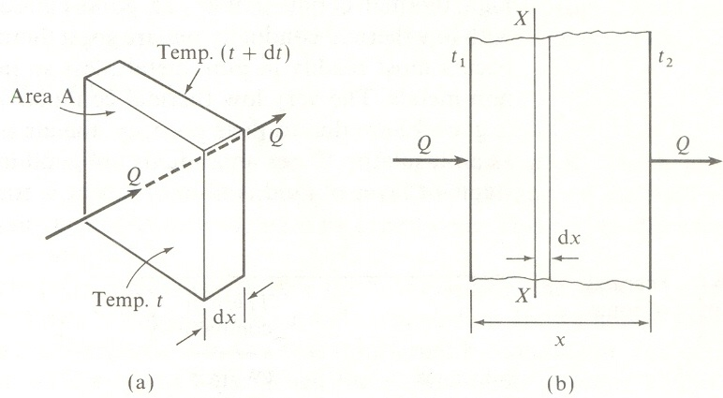
HEAT FLOW THROUGH A THIN SLAB OF MATERIAL
Rate of heat flow, (1.1)
Separating variables and integrating we obtain,
----(1.2)
Notes:
ME 366 LECTURE #1 INTRODUCTION AND UNIT 1 6

Slide 7
VARIATION OF CONDUCTIVITY WITH TEMPERATURE DEMONSTRATED
If the thermal conductivity is assumed to vary linearly with temperature the integration yields the following:
(1.3)
The average thermal conductivity is the value obtained by evaluating its value at the average temperature .
Notes:
ME 366 LECTURE #1 INTRODUCTION AND UNIT 1 7

Slide 8
CONVECTION HEAT TRANSFER
Convection is the mode of heat transfer, which takes place between a solid surface and an adjacent fluid that is in motion as long as the solid and the fluid are at different temperatures and it involves the combined effects of conduction and fluid motion.
The faster the fluid motion, the greater the convection heat-transfer.
In the absence of any bulk fluid motion, heat transfer between a solid surface and the adjacent fluid is by pure conduction. If the bulk fluid motion is artificially induced, say with a fan or a pump, the convection is called forced convection.
On the other hand, if buoyancy forces generated because of density differences resulting from temperature difference cause the fluid motion it is called free or natural convection.
Notes:
ME 366 LECTURE #1 INTRODUCTION AND UNIT 1 8

Slide 9
Convection heat transfer processes: a) Forced convection b) Natural convection c) Boiling d) Condensation
Convection heat transfer processes illustrated
Notes:
ME 366 LECTURE #1 INTRODUCTION AND UNIT 1 9

Slide 10
NEWTON’S LAW OF COOLING:
Newton’s law of cooling states that the heat transfer from a solid surface of Area A, at a temperature, , to a fluid of temperature, T, is given by:
(1.4)
Where is called the heat transfer coefficient. The units of are seen to be W/m² K or kW/m²K. The heat transfer coefficient is an experimentally determined parameter whose value depends on all the variables influencing convection such as surface geometry, the nature of fluid motion, the properties of the fluid, and the bulk fluid velocity. Equation (1.4) does not include the heat loss from the surface by radiation.
Notes:
ME 366 LECTURE #1 INTRODUCTION AND UNIT 1 10

Slide 11
TYPICAL VALUES OF THE CONVECTION HEAT TRANSFER COEFFICIENT
Process
Free convection Gases Liquids Forced convection Gases Liquids Boiling water Condensation steam | 2 – 25 10 – 1,000 25 – 250 50 – 20,000 2,500 – 25,000 5,000 – 100,000
Source: Fundamentals of Heat and Mass Transfer by Incropera and DeWitt (1996)
Notes:
ME 366 LECTURE #1 INTRODUCTION AND UNIT 1 11

Slide 12
RADIATION HEAT TRANSFER
Radiation is the energy emitted by matter in the form of electromagnetic waves as a result of the changes in the electronic configurations of the atoms or molecules.
Radiation is the mode of heat transfer by means of electromagnetic waves between two surfaces or two bodies separated by space, which does not have any medium what so ever.
Energy from the sun, for example, reaches the earth by radiation.
It must be noted that heat transfer by radiation is a significant mechanism of energy transport.
Radiation heat transfer occurs more efficiently in a vacuum.
Notes:
ME 366 LECTURE #1 INTRODUCTION AND UNIT 1 12

Slide 13
STEFAN-BOLTZMANN LAW
Radiation that is emitted by a surface originates from the thermal energy of the matter bounded by the surface, and the rate at which energy is released per unit area (W/m²) is termed the surface emissive power, . There is an upper limit to the emissive power, which is prescribed by the Stefan-Boltzmann law:
(1.5a)
Where is the absolute temperature of the surface and is the Stefan-Boltzmann constant. A surface that emits radiation according this law is called an ideal radiator or blackbody.
NOTE:
Notes:
ME 366 LECTURE #1 INTRODUCTION AND UNIT 1 13

Slide 14
Emissivity explained
The heat flux emitted by a real surface is less than that of a blackbody at the same temperature and is given by:
where is a radiative property of the surface termed emissivity. With values in the range ,this property provides a measure of how efficiently a surface emits energy relative to a blackbody. It depends strongly on the surface material and finish. It must be noted that a smooth surface reflects radiation specularly, while a rough surface reflects radiation diffusely. Hence, rough surfaces are much betters absorbers of radiation than smooth surfaces.
Notes:
ME 366 LECTURE #1 INTRODUCTION AND UNIT 1 14

Slide 15
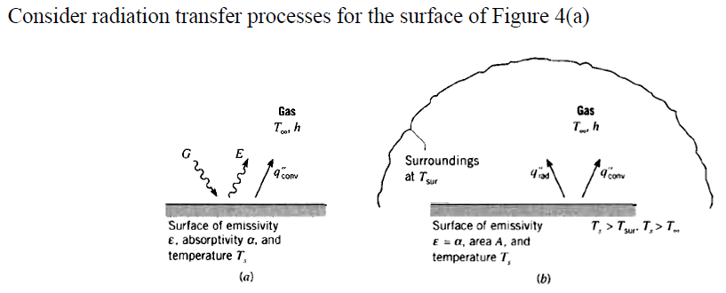
Concept of irradiation (G) explained
If the surface is assumed to be that for which (a grey body), the net rate radiation heat transfer from the surface, expressed per unit area of the surface is
Notes:
ME 366 LECTURE #1 INTRODUCTION AND UNIT 1 15

Slide 16
Radiation concluded
There are many applications for which it is convenient to express the net radiation heat exchange in the form.
(1.7)
Where, from Equation (1.7), the radiation heat transfer coefficient α_{r} is:
(1.8)
Here, we have modelled the radiation mode in a manner similar to convection. In this sense, we have linearised the radiation rate equation. Its importance is in solar energy problems for purposes of modelling.
Notes:
1. The rate of heat transfer per unit area normal to the direction of heat transfer is called heat flux, and the average heat flux on a surface is expressed.
(1.9)
where A is the heat transfer area normal to the direction of heat transfer.
The unit of heat flux in SI units is W/m².
2. Application to solar air-heaters and solar collectors. (Energy balance analysis for the different components, steady-state solution and transient analysis.)
Notes:
ME 366 LECTURE #1 INTRODUCTION AND UNIT 1 16

Slide 17
THE CONSERVATION OF ENERGY REQUIREMENT
THE FIRST LAW OF THERMODYNAMICS
For many heat transfer problems, the first law of thermodynamics (the law of conservation of ­energy) provides a useful tool. In applying the first law, we need to identify the control volume, a region of space bounded by a control surface through which energy and matter may pass. Once the control volume is identified, an appropriate time basis must be specified. One option involves formulating the law on a rate basis. That is, at any instant, there must be a balance between all energy rates. Alternatively, the first law must also be satisfied over any time interval. For such an interval, there must be a balance between the amounts of all energy changes.
According to the time basis, the first law formulations that we are suited for heat transfer analysis may be stated as follows.
At an Instant: The rate at which thermal and mechanical energy enters a control volume, plus the rate at which thermal energy is generated within the control volume, minus the rate at which thermal and mechanical energy leaves the control volume must equal the rate of increase of energy stored within the control volume.
(1.10)
Equation (1.10) may be applied at any instant of time. The alternative form that applies for a time interval ∆t is obtained by integrating equation (1.10) over time:
Notes:
ME 366 LECTURE #1 INTRODUCTION AND UNIT 1 17

Slide 18
OVER AN INSTANT:
The amount of thermal and mechanical energy that enters a control volume, plus the amount of thermal energy that is generated within the control volume, minus the amount of thermal and mechanical energy that leaves the control volume must equal the increase in the amount of energy stored in the control volume.
A general form of the conservation requirement may then be expressed as follows: ------- (1.11)
Notes:
ME 366 LECTURE #1 INTRODUCTION AND UNIT 1 18

Slide 19
Unit 1 concluded
The inflow and outflow terms are surface phenomena.
The energy generation term is associated with conversion from some other energy form to thermal energy and it is a volumetric phenomenon.
Energy storage is also a volumetric phenomenon, and changes within the control volume may be due to changes in the internal, kinetic, and/or potential energies of its contents.
We will frequently have occasion to apply the conservation of energy requirement at the surface of a medium. In this special case, the control surface includes no mass or volume. Equation 1.10, are no longer relevant and it is only necessary to deal with surface phenomena. For this case (steady state), the conservation requirement becomes
(1.12)
Even though thermal energy generation may be occurring in the medium, the process would not affect the energy balance at the control surface. Moreover, this conservation requirement holds for both steady state and transient conditions.
Notes:
ME 366 LECTURE #1 INTRODUCTION AND UNIT 1 19

Slide 20
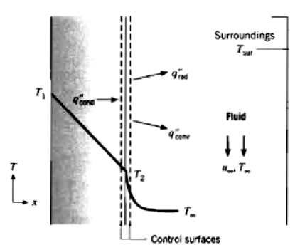
Worked Examples
The hot combustion gases of a furnace are separated from the ambient air and its surroundings, which are at 25°C, by a brick wall 0.15 m thick. The brick has a thermal conductivity of 1.2 W/m K and a surface emissivity of 0.8. Under steady state conditions, an outer surface temperature of 100°C is measured. Free convection heat transfer to the air adjoining the surface is characterised by a convection coefficient of α = 20 W/m² K. What is the brick inner surface temperature?
Solution
Notes:
ME 366 LECTURE #1 INTRODUCTION AND UNIT 1 20

Slide 21
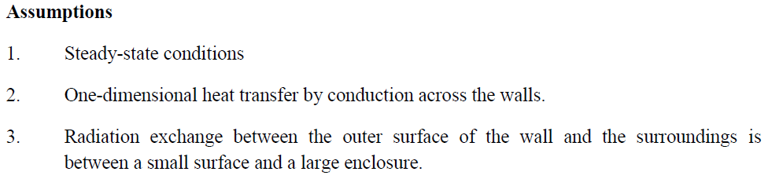
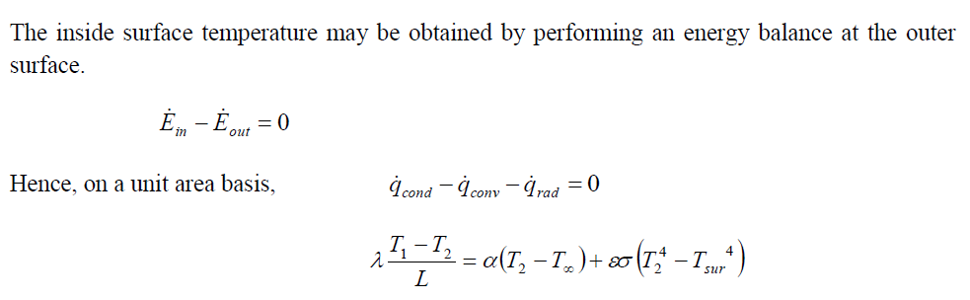
solution contd.
Notes:
ME 366 LECTURE #1 INTRODUCTION AND UNIT 1 21

Slide 22
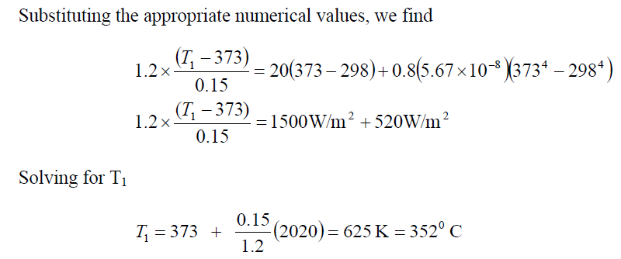
solution contd.
Notes:
ME 366 LECTURE #1 INTRODUCTION AND UNIT 1 22

Slide 23
Example 1.2
An insulated steam pipe passes through a room in which the air and walls are at 25⁰C. The outside diameter of the pipe is 70 mm, and its surface temperature and emissivity are 200⁰C and 0.8, respectively. What are the surface emissive power and irradiation? If the coefficient associated with free convection heat transfer from the surface to the air is 15 W/m² K, what is the rate of heat loss from the surface per unit length of the pipe.

Slide 24
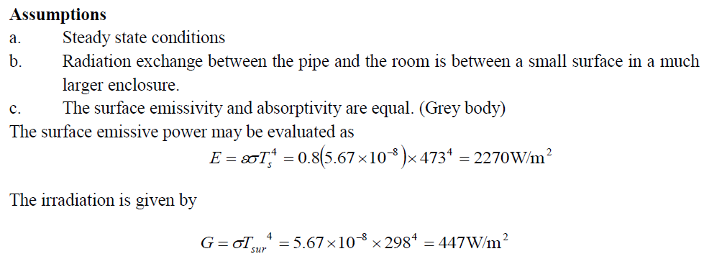
solution
Notes:
ME 366 LECTURE #1 INTRODUCTION AND UNIT 1 24

Slide 25
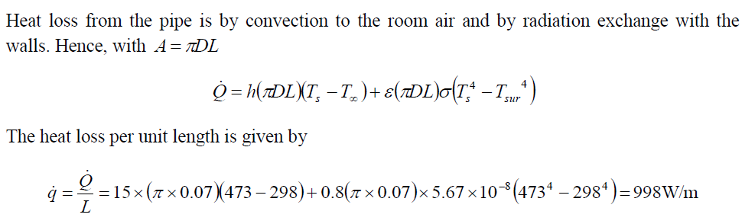
solution Contd.
Notes:
ME 366 LECTURE #1 INTRODUCTION AND UNIT 1 25

Slide 26
REVIEW PROBLEM:
Q.1 A closed container filled with hot coffee is in a room whose air and walls are at a fixed temperature. Identify all heat transfer processes, (q₁ to q₈) as shown in the figure below, that contribute to cooling of the coffee. Comment on features that would contribute to a superior container design.
Q.2 A heat rate of 3 kW is conducted through a section of an insulating material of cross­-sectional area 10m² and thickness 2.5 cm. If the inner (hot) surface temperature is 415⁰C and the thermal conductivity of the material is 0.2 W/m K, what is the outer surface temperature? Suggested Answer: 377.5 ⁰C

Slide 27
Question 1 discussed
Solution to Q.1
q₁ free convection from the coffee to the flask
q₂ conduction through the flask
q₃ free convection from the flask to the air
q₄ free convection from the air to the cover
q₅ net radiation exchange between the outer surface of the flask and the inner surface of the cover
q₆ conduction through the cover
q₇ free convection from the cover to the room air
q₈ net radiation exchange between the outer surface of the cover and the surroundings
Improving container design
Use of aluminized (low emissivity) surfaces for the flask and cover to reduce net radiation, and
Evacuating the air space or using a filler material to retard free convection.
Notes:
ME 366 LECTURE #1 INTRODUCTION AND UNIT 1 27

Slide 28
Heat transfer modes illustrated
Exploded view
Notes:
ME 366 LECTURE #1 INTRODUCTION AND UNIT 1 28

Slide 29
LECTURE ENDS
THANK YOU MY STUDENTS
LUKE 19:13
Notes:
ME 366 LECTURE #1 INTRODUCTION AND UNIT 1 29

